Slide 1
Infrastructure Automation with Terraform & Azure Devops on Azure cloud
Harshal Mittal

Slide 2
Modules using terraform registry Section 6
Notes:
Lets learn about modules and using Terraform registry

Slide 3
Modules using remote source
Terraform supports remote sources for modules.
Notes:
Modules can either be loaded from the local filesystem, or a remote source.
In this section we are going to apply a module from a remote source. Where root module code is already exist in terraform registry.

Slide 4
Modules using terraform registry
Terraform supports remote sources for modules.
Publish the modules on the Terraform registry, it can be used in your configuration by defining that source in the module block.
Notes:
You can publishing your module if you like to share with your other team mates on the Terraform Registry. In this way it can be used in your configuration by defining that source in the module block.

Slide 5
Modules using terraform registry
Terraform supports remote sources for modules.
Publish the modules on the Terraform registry, it can be used in your configuration by defining that source in the module block.
Using “Azure/vnet/azurerm” terraform registry in our lab.
Notes:
In our lab, we deployed 2 separate vnets, one in front end and second in the backend. I am going to use azure vnet module sourced from terraform registry, to redeploy our lab using that module.

Slide 6
Modules using terraform registry
Terraform supports remote sources for modules.
Publish the modules on the Terraform registry, it can be used in your configuration by defining that source in the module block.
Using “Azure/vnet/azurerm” terraform registry in our lab.
module "vnet" {
source = "Azure/vnet/azurerm“
}
Notes:
Here is an example of module block which we will use in our code to call that module.

Slide 7
Modules using terraform registry
Terraform supports remote sources for modules.
Publish the modules on the Terraform registry, it can be used in your configuration by defining that source in the module block.
Using “Azure/vnet/azurerm” terraform registry in our lab.
module "vnet" {
source = "Azure/vnet/azurerm“
}
https://registry.terraform.io/modules/Azure/vnet/azurerm/2.1.0
Notes:
Here is the documentation link for this module, which we will refer in our lab, about using this module.

Slide 8
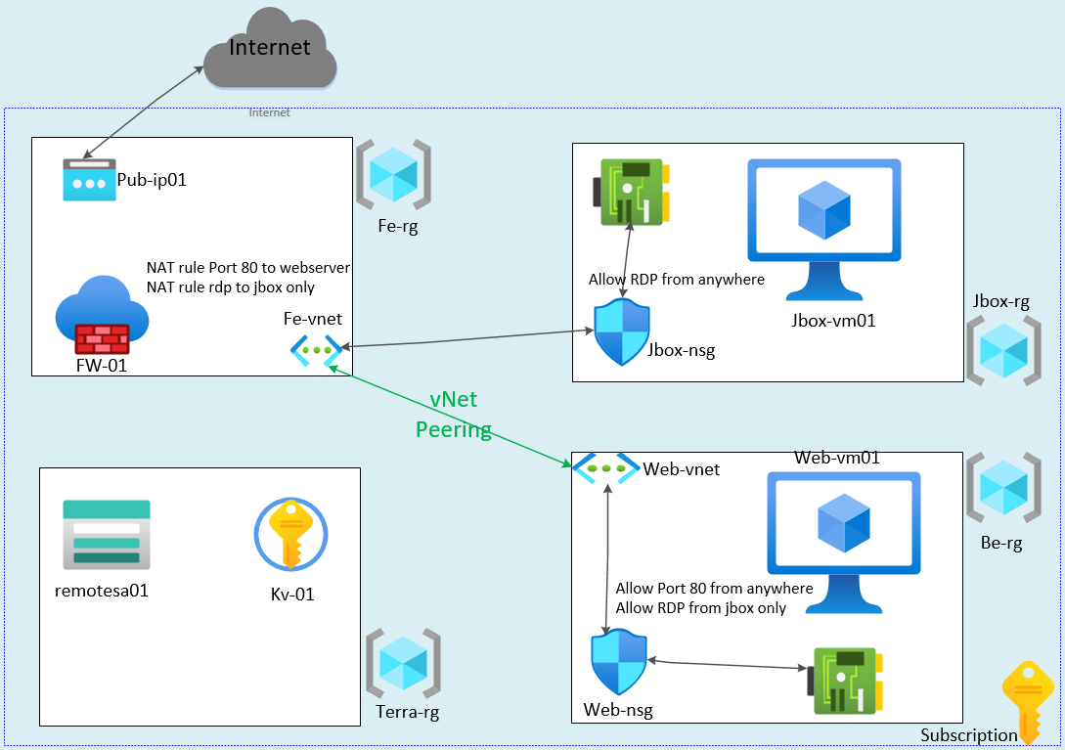
Redesign lab using remote module
Notes:
Now let us redesign our lab again using terraform registry modules for the deployment of azure vnet.
I have circled in red both vnets which we are going to deploy in our lab.

Slide 9
Demo
Notes:
Let us configure our lab and using module from terraform registry and after that we will test our lab.

Slide 10
Managing multiple environments and dependencies
Next video
Notes:
This concludes the end of this section, in the next section we will learn how to manage Multiple Environments and Dependencies in terraform.

